Slide 1

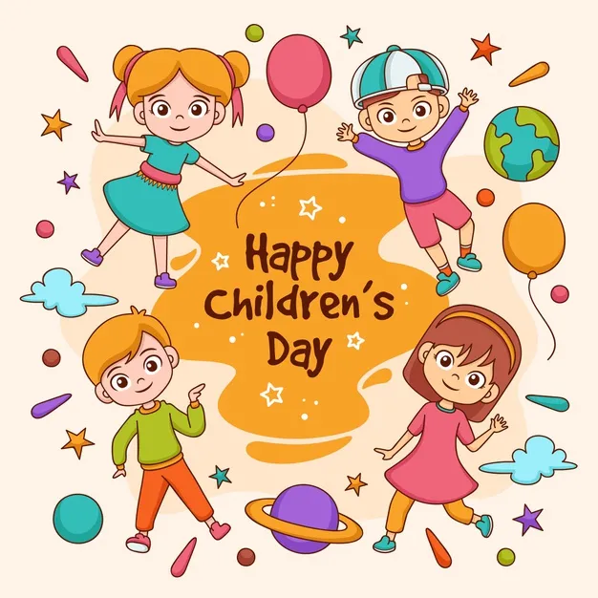
Children’s Day 2021
By-Jahanvi

Slide 2
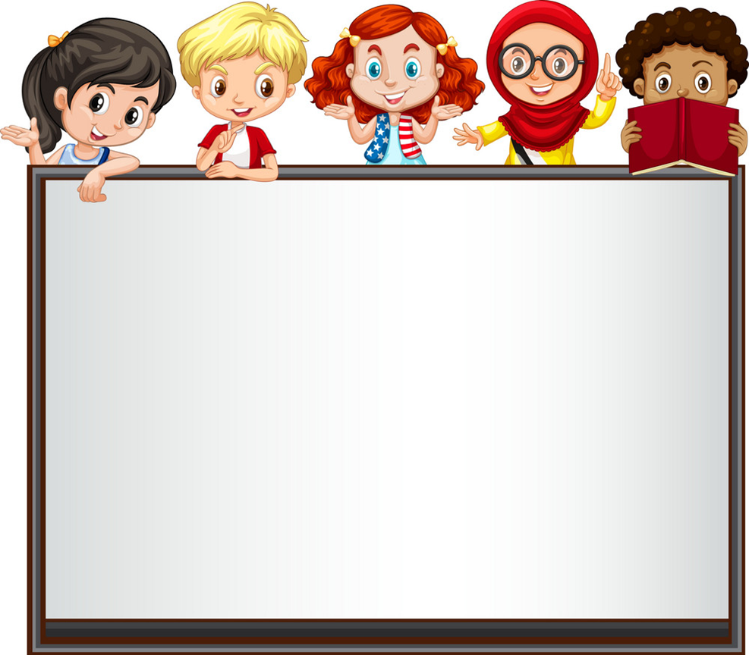
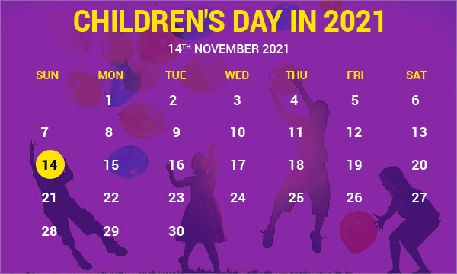
Date of Children’s Day 2021
Date-14 November Sunday 2021

Slide 3

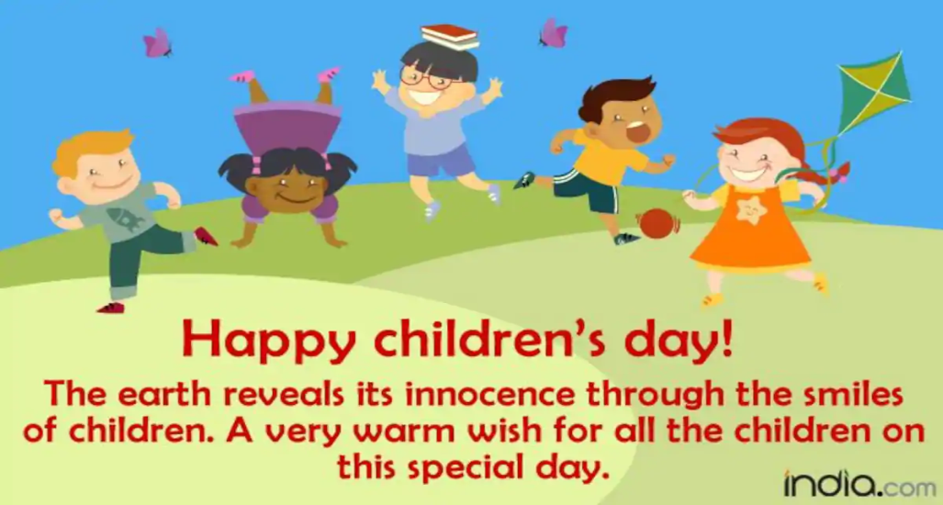
How do we celebrate Children’s Day?
Children's Day in India is celebrated with fun in schools and other educational institutions. Children are presented with toys, sweets and gifts as an attempt to make the day special for them. The birth anniversary of Pandit Jawaharlal Nehru will be held amidst the coronavirus pandemic this year.

Slide 4


